Slide 1

International Euro Road Network
Result of Social Network Analysis of
Using Neo4j
Peachapong Poolpol

Slide 2
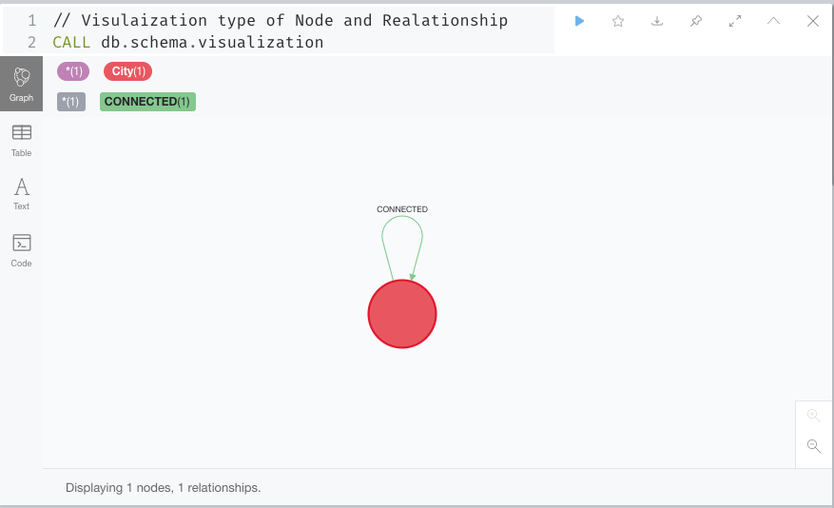
Visualization type of Node and Edge in database

Slide 3
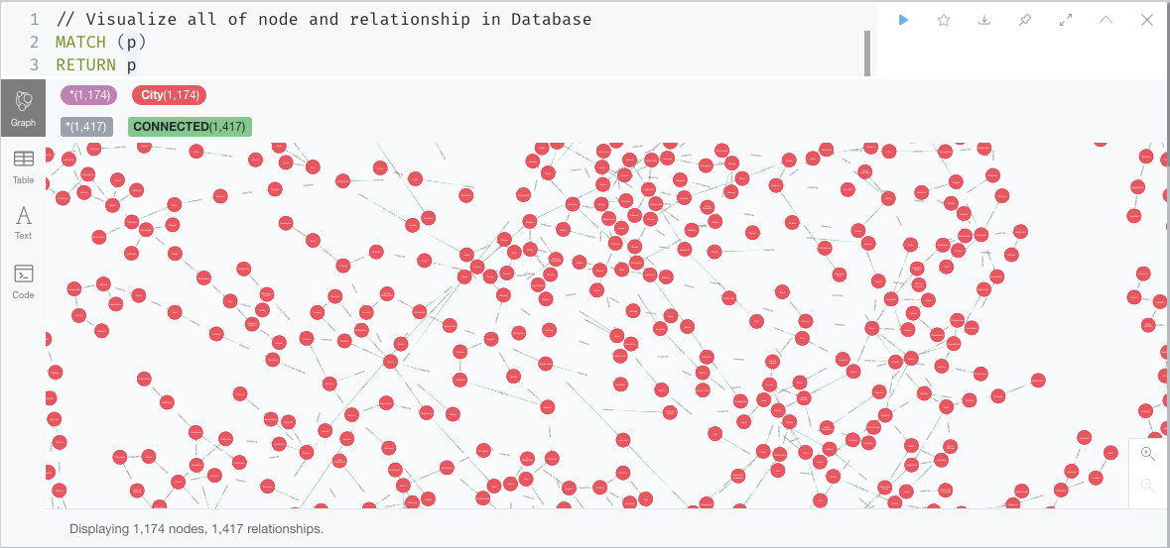
Visualization all Nodes and Edges

Slide 4
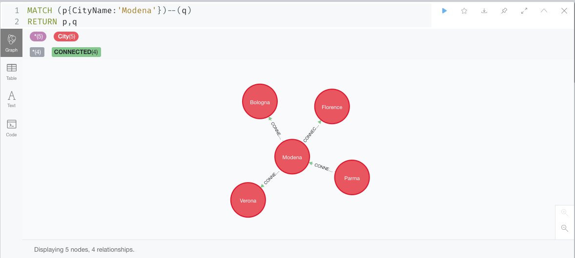
Try to find the nodes named Modena and its adjacent nodes

Slide 5
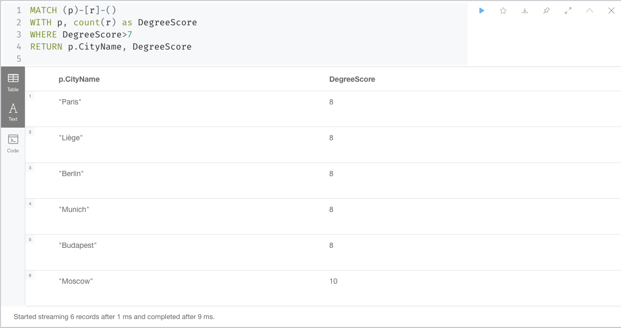
Find node where have degree more than 7

Slide 6
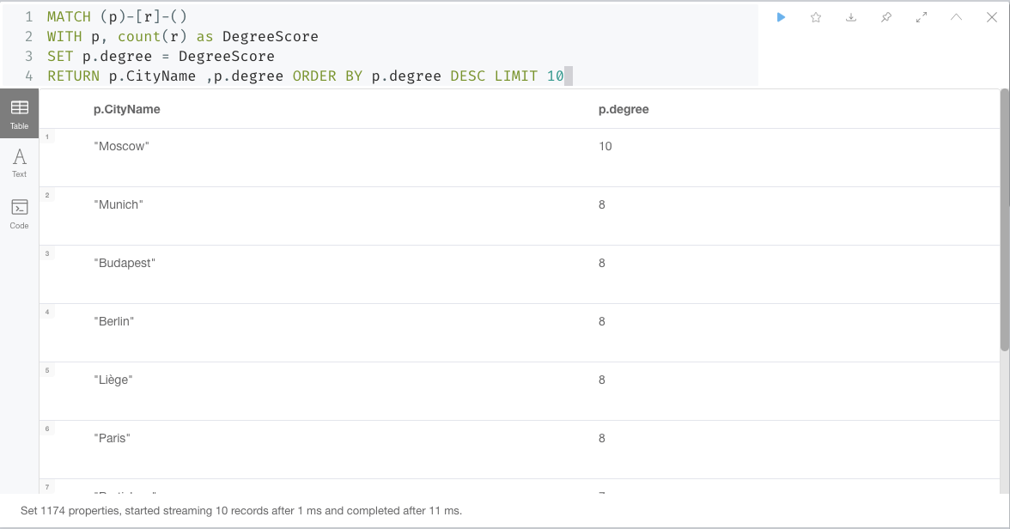
Show nodes where are the top 10 of highest degree

Slide 7
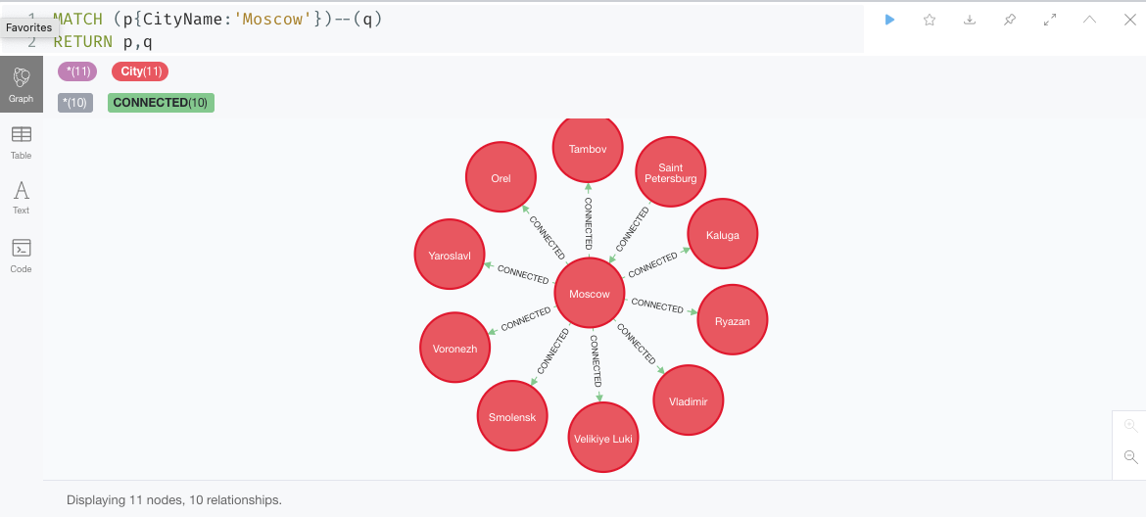
Show the relationship of Node named Moscow which has highest degree

Slide 8
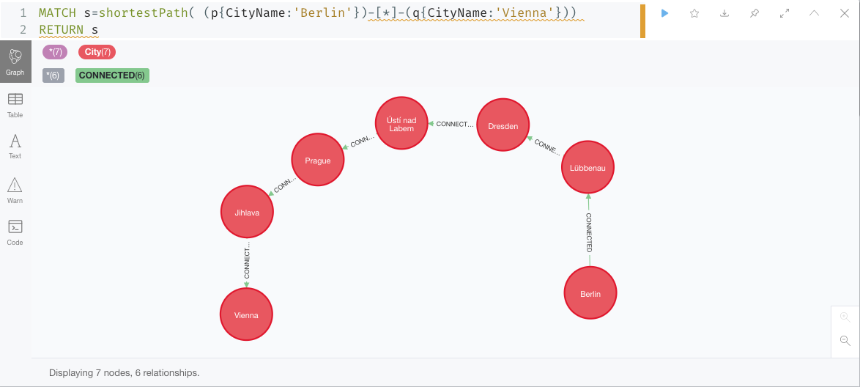
Find the shortest path from Berlin to Vienna

Slide 9
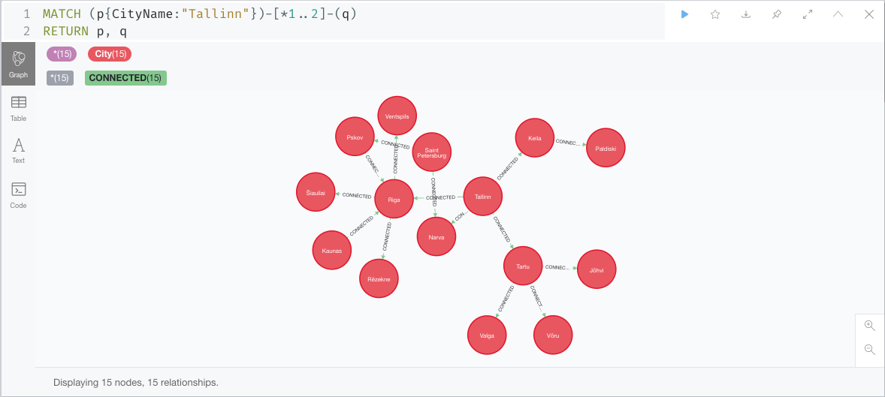
Find 2 hop cities away from Tallinn

Slide 10
Centrality

Slide 11
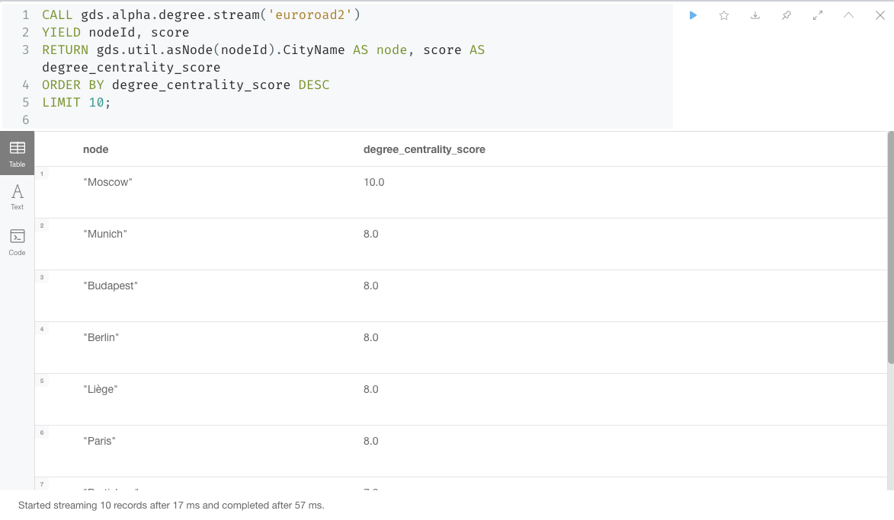
Find Degree centrality using GDS by showing top ten of degree centrality

Slide 12
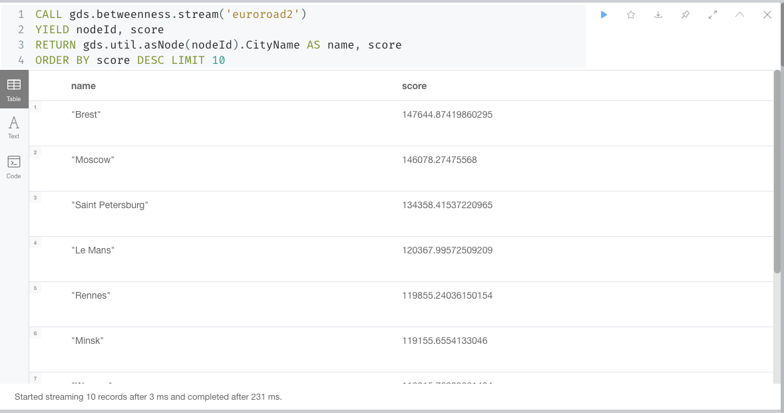
Find Betweenness Centrality using GDS by showing top ten of Betweenness Centrality

Slide 13
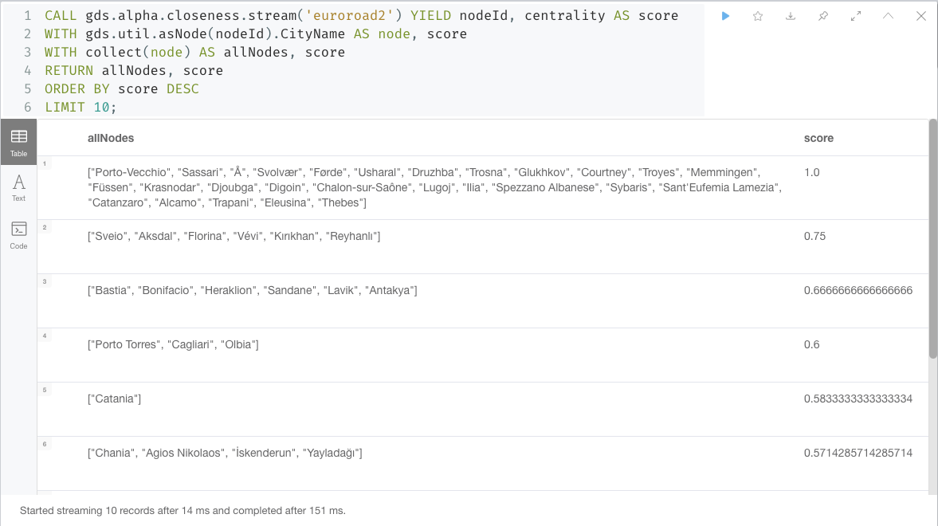
Find Closeness Centrality using GDS by showing top ten of Closeness Centrality

Slide 14
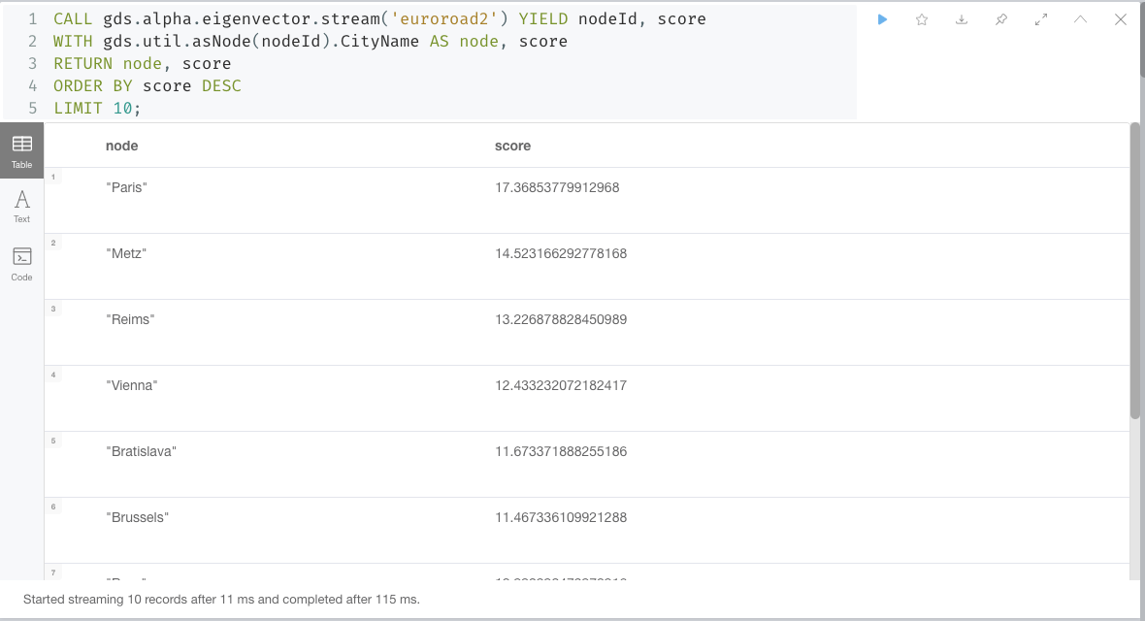
Find Eigenvector Centrality using GDS by showing top ten of Eigenvector Centrality

Slide 15
Community Detection

Slide 16
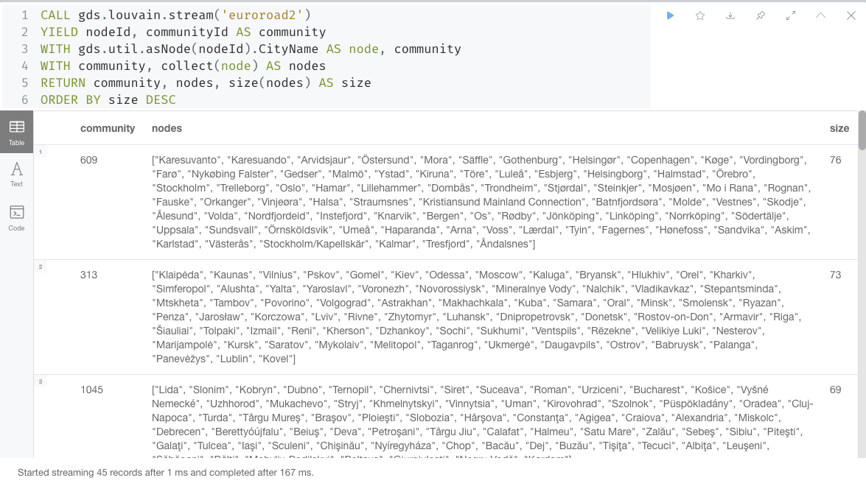
Louvain method

Slide 17
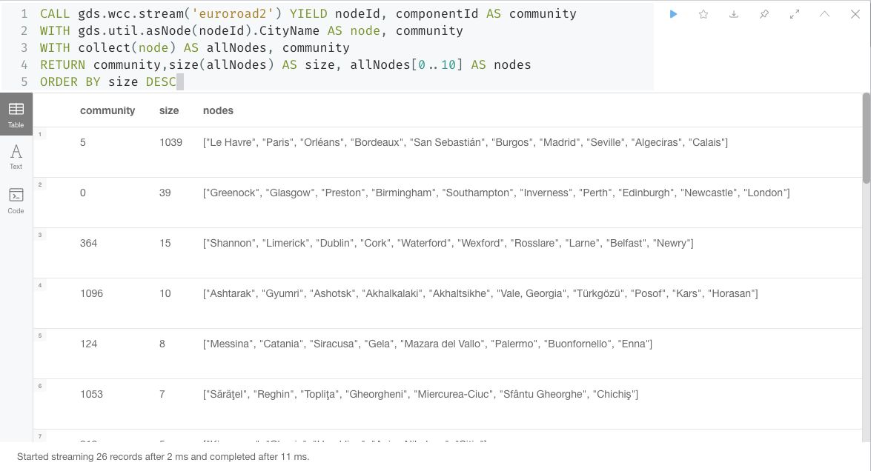
Weakly Connected Component

Slide 18
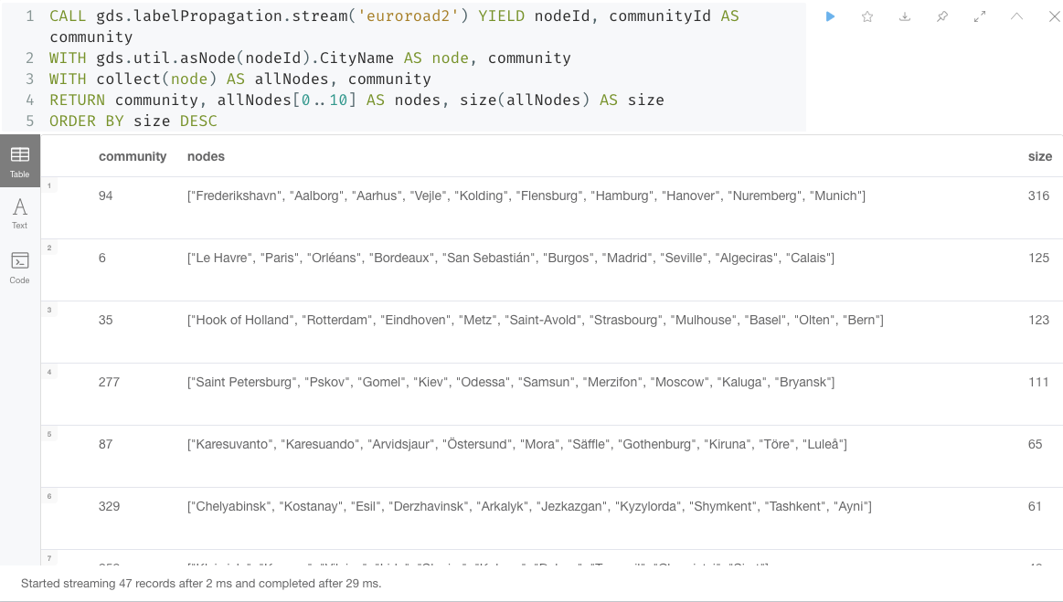
Label Propagation Algorithm

Slide 19
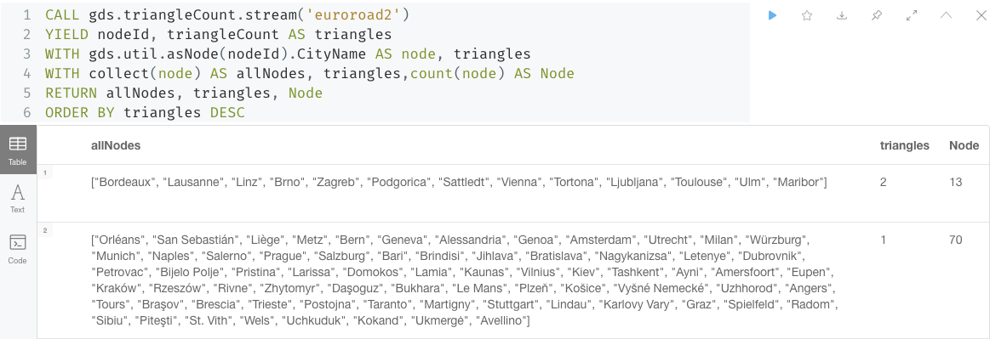
Triangle count

Slide 20
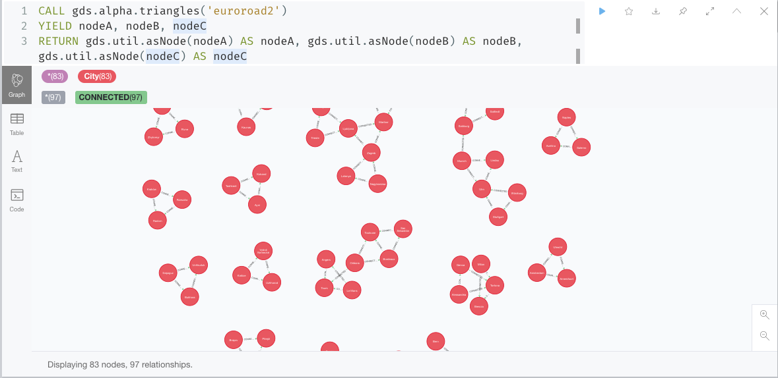
Triangle count with graph visualization

Slide 21
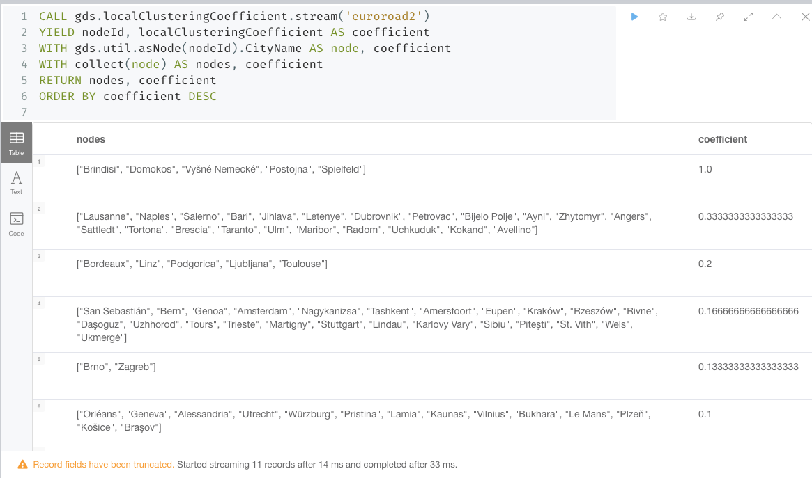
Local Clustering Coefficient

